Slide 1
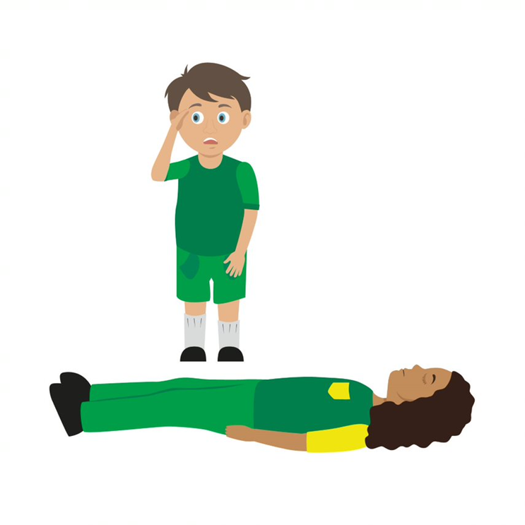

Starter Activity
Primary Survey
Use your current first aid knowledge to explain what you could do for each of the 6 steps.
Step 1.
Step 2.
Step 3.
Check for d_ _ _ _ _
Always make sure the area is _ _ _ _
R_ _ _ _ _ _ _
Check the casualty’s response. Ask q_ _ _ _ _ _ _s and gently tap shoulders. Say, “______ ______ ______!”
Shout for h _ _ _
Anyone nearby can a_ _ _ _ _ you
Step 4.
Step 5.
Step 6.
A_ _ _ _ _
If not c_ _ _ _, then open by
t_ _ _ _ _ _ the head back, use one hand on f_ _ _ _ _ _ _ and two fingers under the c_ _ _
B_ _ _ _ _ _ _ _
Check for n_ _ _ _ _ breathing. Use look, listen and feel to check. (Remember 10 seconds!)
C_ _ _ _ _ _ _ _ _ _ (only if breathing normally)
Check the casualty for b_ _ _ _ _ _ _
NB
At this time please do not put your face near to theirs to check for breathing, instead only look carefully for
the chest rising and falling.
If the casualty is not breathing normally call 999/112 then start CPR
If the casualty is breathing normally place them in the recovery position then call 999/112

Slide 2
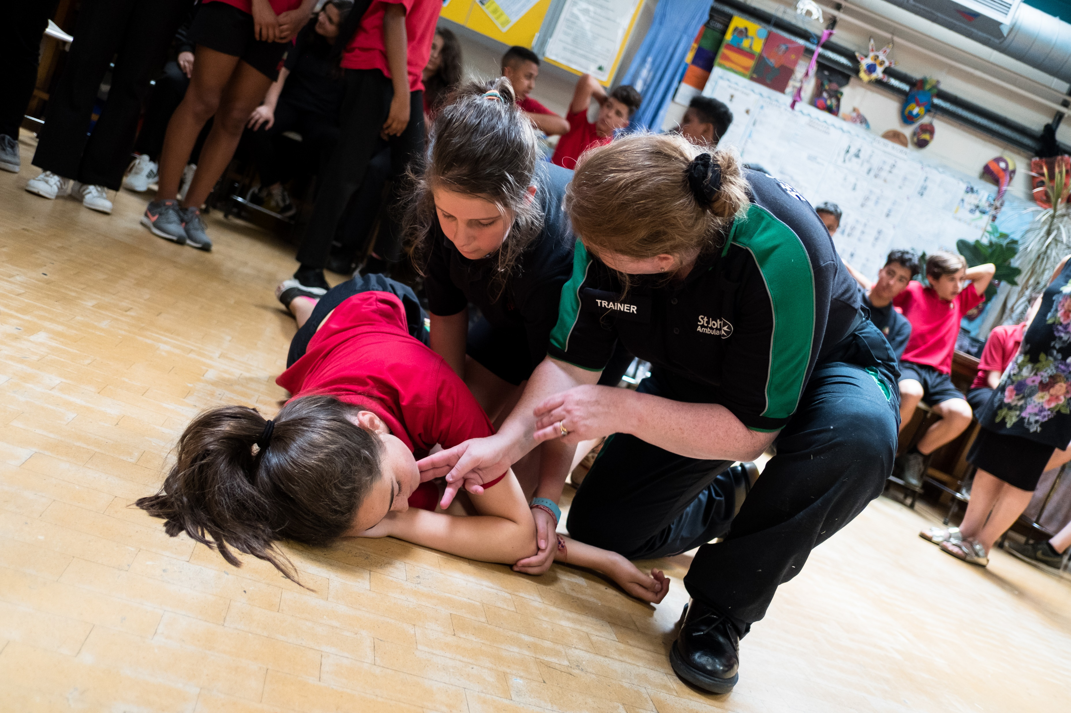


Basic life support
KS3 – Basic life support

Slide 3
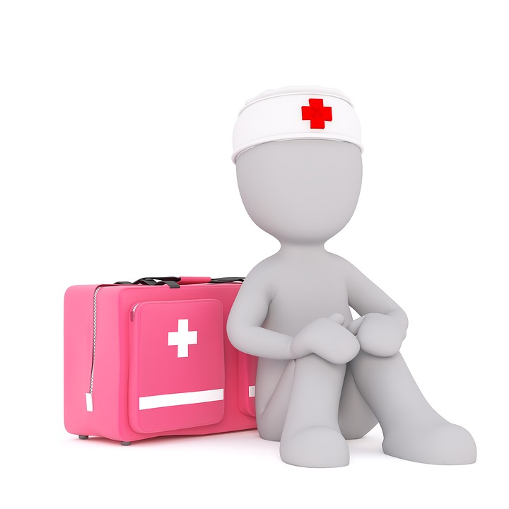
Basic life support
A short course for young people to learn how to deal with first aid emergencies.

Slide 4
Learning outcomes
I am able to carry out a primary survey
I can place an unresponsive casualty, who is breathing normally, into the recovery position
I know when and how to deliver CPR to an unresponsive casualty who is not breathing normally
I can ensure the safety of myself and others
Notes:
Teacher should refer to ground rules for the session at this stage

Slide 5
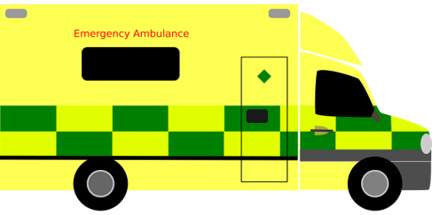
When things go wrong A12
Think of something that could happen to make someone unresponsive.
Notes:
Explain the heart needs air (oxygen) and it’s a muscle that pumps blood around the body.
What can go wrong to cause a problem to the air and blood circulating? (circulation = "circling" the body)
Brief explanation and onto worksheet
General discussion - hit head, run over, choking etc. Emphasis on if it affects breathing, brain or heart (circulation) then this can cause unresponsiveness.

Slide 6
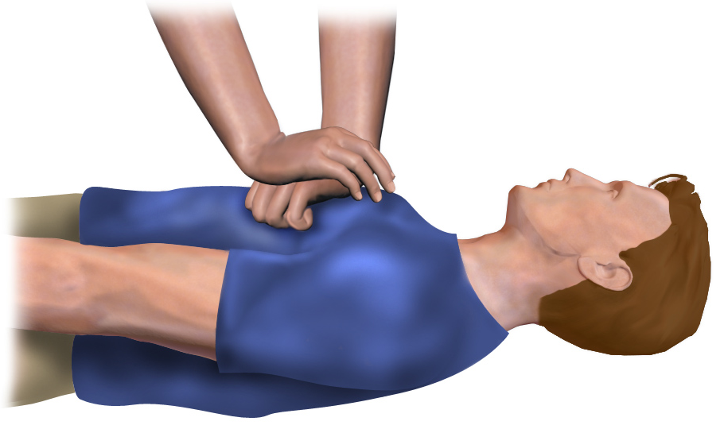
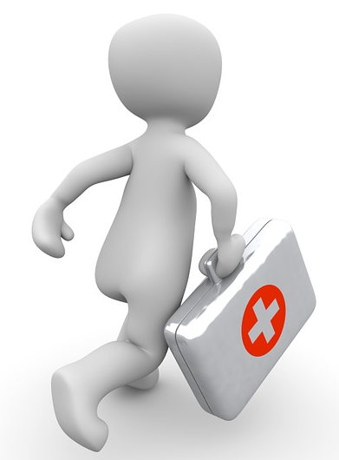
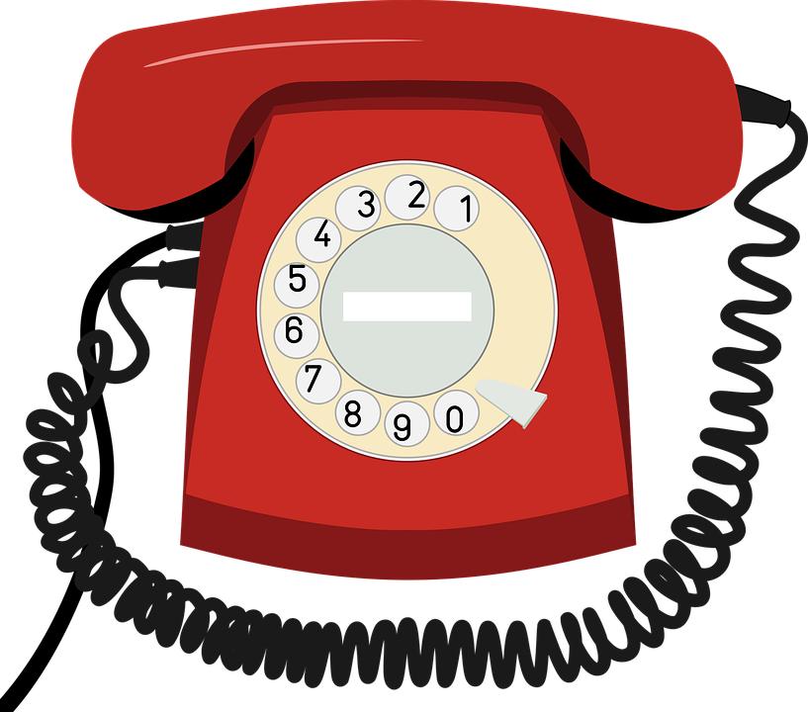

Chain of survival A13
Early CPR
Post resuscitation
Call for help
Early defibrillation
care
Discuss: Describe each link of the chain of survival
Challenge: Explain why it is important to follow these links?
Notes:
Chain of survival- if all steps in place MAY increase chance of survival
Note even best efforts at times do not ensure success when trying to resuscitate a casualty

Slide 7

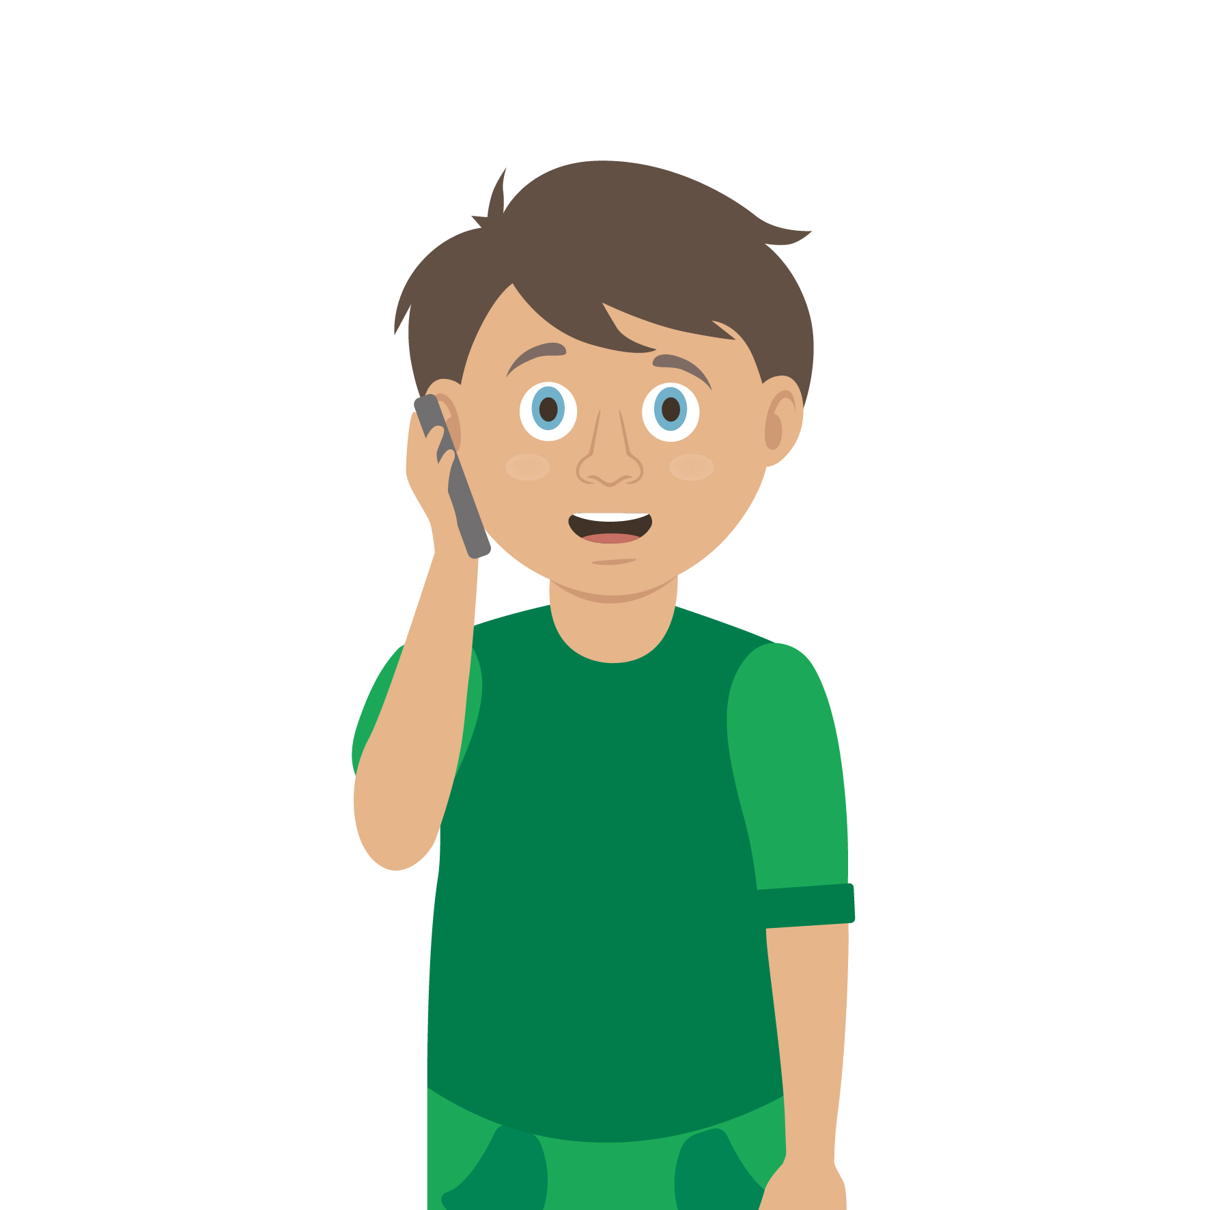
Primary survey
You do a primary survey to assess a casualty.

Slide 8
Primary survey
D
Don’t / Danger / Dodge / Drive
Rescue / Run / Response / Repair
Silence / Summon / Slap / Shout
Automatic / Arm / Awful / Airway
Breathing / Back / Bruise / Belly
Catch / Cough / Circulation / Casualty
Choose the correct word for each part of the primary survey.
R
S
A
Why is it important that we use DRsABC?
B
C
Notes:
ANSWERS: DANGER,RESPONSE,AIRWAY, BREATHING,CIRCULATION
Important as it structures approach

Slide 9

Watch this video
Primary Survey
This video was filmed before the COVID-19 pandemic. At this time please do not put your face next to theirs to check for breathing, instead only look carefully for the chest rising and falling.
KS3 – Basic life support

Slide 10
Your turn: Primary survey
1. Check for danger
Always make sure the area is safe
2. Response
Check the casualty’s response. Ask questions and gently tap shoulders. Say “open your eyes!”
3. Shout for help
Anyone nearby can assist you
5. Breathing
Check for normal breathing. Do not put your face next to theirs, instead look at chest rising and falling only. (Remember 10 seconds!)
4. Airway
If not clear, then open by tilting the head back, use one hand on forehead and two fingers under the chin
6. Circulation (only if breathing normally)
Check the casualty for bleeding
NB
At this time do not put your face near to theirs to check for breathing, instead look at chest rising and falling only
If the casualty is not breathing normally call 999/112 then start CPR
If the casualty is breathing normally place them in the recovery position then call 999/112
Notes:
Scenario cards are available which the teacher can use to make the practical activity relevant in a certain context for students.
Trainer demonstrates then gets the students to practice using either the PP slide as a prompt or the sheet in the workbook. Trainer circulate and correct as necessary

Slide 11

What’s next?
Is the casualty unresponsive but breathing normally?
If YES, then place the casualty into the recovery position.
Primary survey completed?

Slide 12
Watch this video
Recovery Position
This video was filmed before the COVID-19 pandemic. At this time please do not put your face next to theirs to check for breathing, instead only look carefully for the chest rising and falling.
KS3 – Basic life support

Slide 13
Your turn: Recovery position
1. Kneel
By the side of your casualty
2. Angle arm
Put the arm nearest to you to make a right angle. Palm facing upwards
3. Hand to cheek
Bring the arm furthest away across the chest and place the back of their hand against the cheek nearest to you
Hold it there
4. Knee bend
With other hand, bend their far knee up so that the foot is flat on the floor
5. Knee pull
Pull on the knee to roll the casualty towards you onto their side
Adjust them as necessary
6. Ensure airway is open
Recheck breathing
Call 999/112
Stay and monitor casualty until help arrives
KS3 – Basic life support
Notes:
Trainer demonstrates then gets the students to practice using either the PP slide as a prompt or the sheet in the workbook. Trainer circulate and correct as necessary
Scenario cards are available which the teacher can use to make the practical activity relevant in a certain context for students.

Slide 14
What’s next?
Call 999/112 for emergency help and start CPR. You can instruct an adult how to do this if you cannot do it yourself.
Primary survey completed?
Is the casualty unresponsive and not breathing normally?

Slide 15
Watch this video
CPR
KS3 – Basic life support

Slide 16
CPR remember…
You may not be strong/confident enough to do CPR on a casualty. That’s OK, you can tell someone else what they need to do
It is important to understand that sometimes even CPR cannot save somebody
Anything you can do to help, even just calling someone else to help, could be lifesaving
Never do CPR on someone if they are responsive and breathing normally

Slide 17
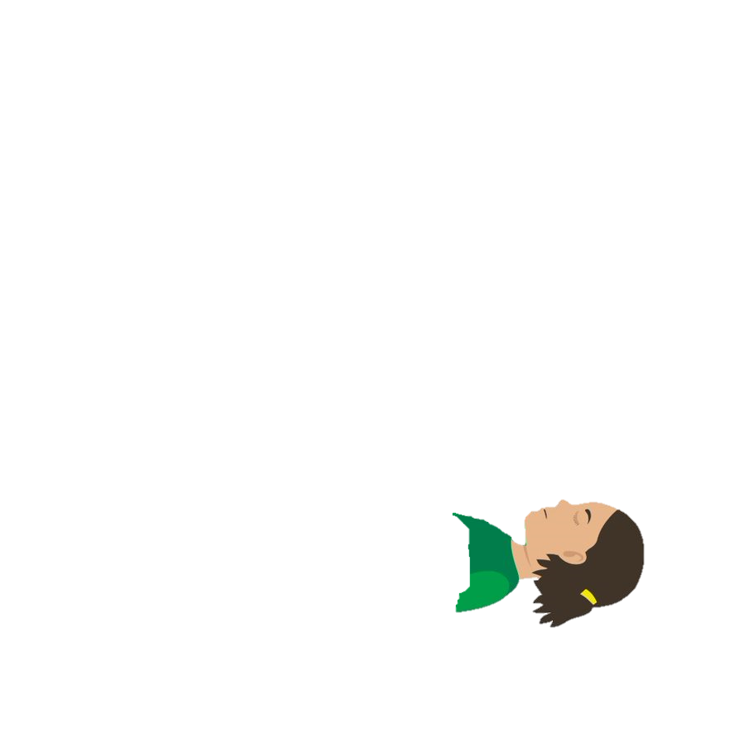

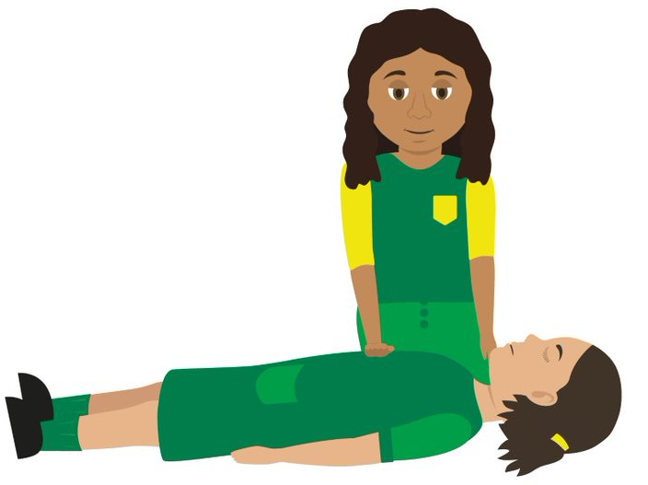

Your turn: CPR
1. If you find someone collapsed, you should first perform a primary survey. Do not place your face close to theirs.
If you have established from this that they are unresponsive and not breathing, you should ask a helper to call 999 or 112 for emergency help while you start CPR. Ask a helper to find and bring a defibrillator, if available.
Ask your helper to put the phone on speaker and hold it out towards you, so they can maintain a 2m distance.
If you are on your own, use the hands-free speaker on a phone so you can start CPR while speaking to ambulance control.
Do not leave the casualty to look for a defibrillator yourself. The ambulance will bring one.
2. Before you start CPR, use a towel or piece of clothing and lay it over the mouth and nose of the casualty.
Start CPR. Kneel by the casualty and put the heel of your hand on the middle of their chest. Put your other hand on top of the first. Interlock your fingers making sure they don't touch the ribs.
Keep your arms straight and lean over the casualty. Press down hard, to a depth of about 5-6cm before releasing the pressure, allowing the chest to come back up.
The beat of the song "Staying Alive" can help you keep the right speed
Do not give rescue breaths.
3. Continue to perform CPR until:
emergency help arrives and takes over
the person starts showing signs of life and starts to breathe normally
you are too exhausted to continue (if there is a helper, you can change over every one-to-two minutes, with minimal interruptions to chest compressions)
a defibrillator is ready to be used.
4. If the helper returns with a defibrillator, ask them to switch it on and follow the voice prompts while you continue with CPR.
Wherever possible, the helper should keep a distance of 2m.
NEVER do this on someone if they are responsive! At this time please do not put your face next to theirs to check for breathing, instead only look carefully for the chest rising and falling. When giving CPR place a cloth over the face of the casualty
Notes:
Stress NOT doing this on someone who is breathing normally

Slide 18
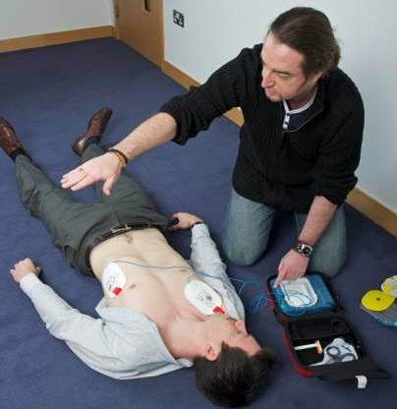
Using the AED
AED stands for automated external defibrillator. This is an emergency life-saving device used in the event of sudden cardiac arrest. The device analyses the heart rhythm and administers an electrical charge to the heart if needed to establish a regular heartbeat.
  Turn the AED on
  Follow all the AED voice prompts
  Ensure no one is touching the casualty when it is analysing
  Ensure no one is touching the casualty before pushing the shock button
KS3 – Basic life support

Slide 19
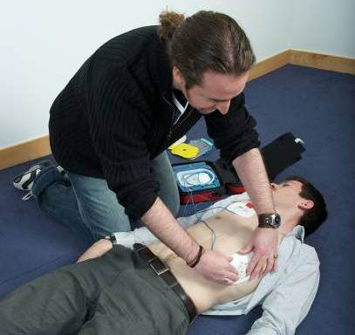
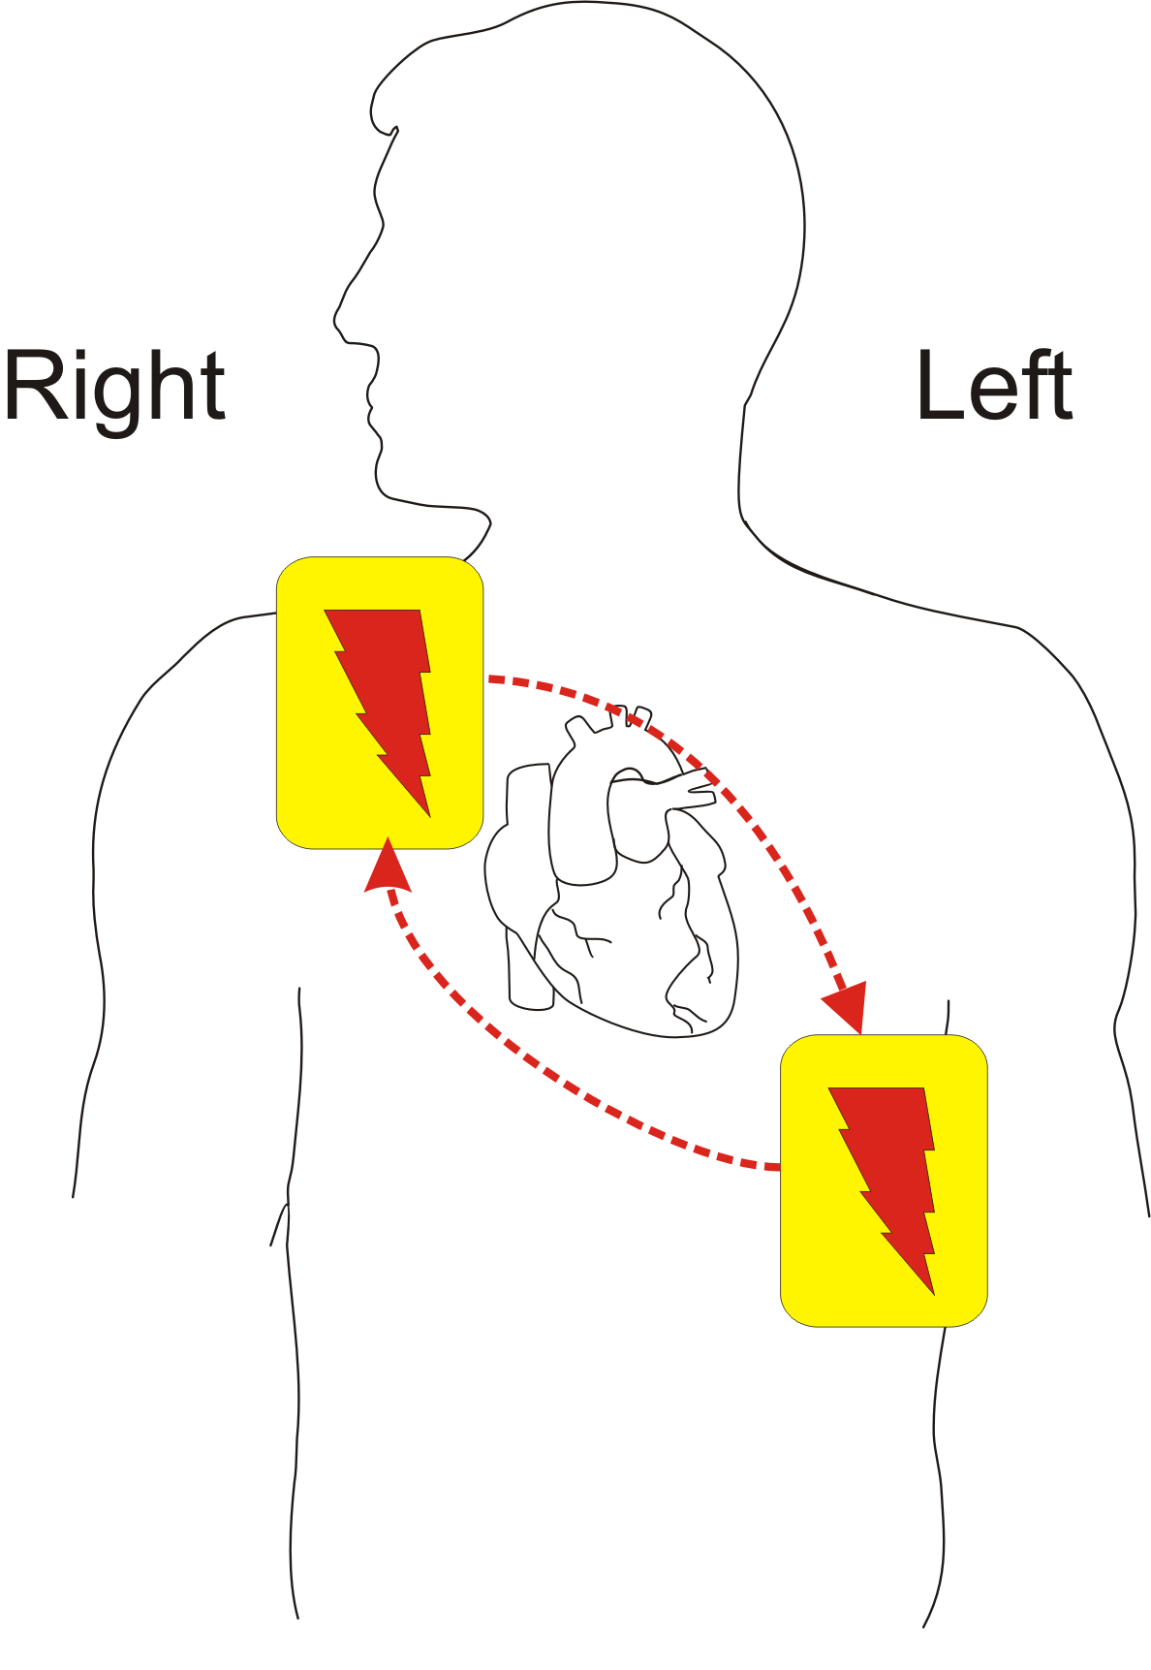
Connecting the AED pads
  Ensure that the chest is dry
  Consider shaving the chest if it is hairy
  Use the pre-prepared pads that come with the AED, they are ready to use.
  Stick the pads onto the chest as indicated on the pads.
  Ensure each pad is securely attached
KS3 – Basic life support

Slide 20
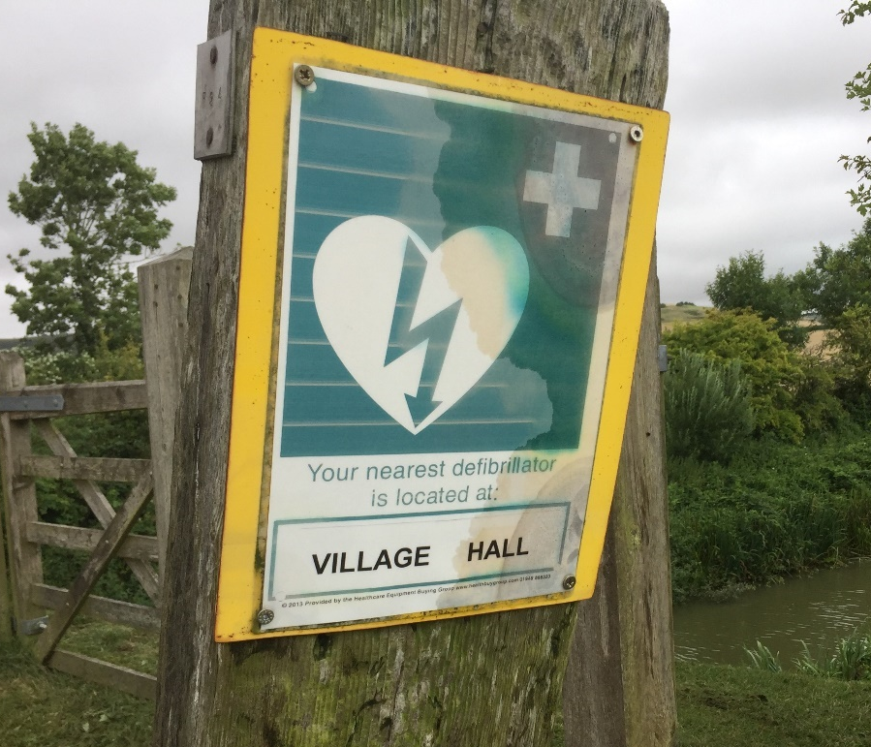
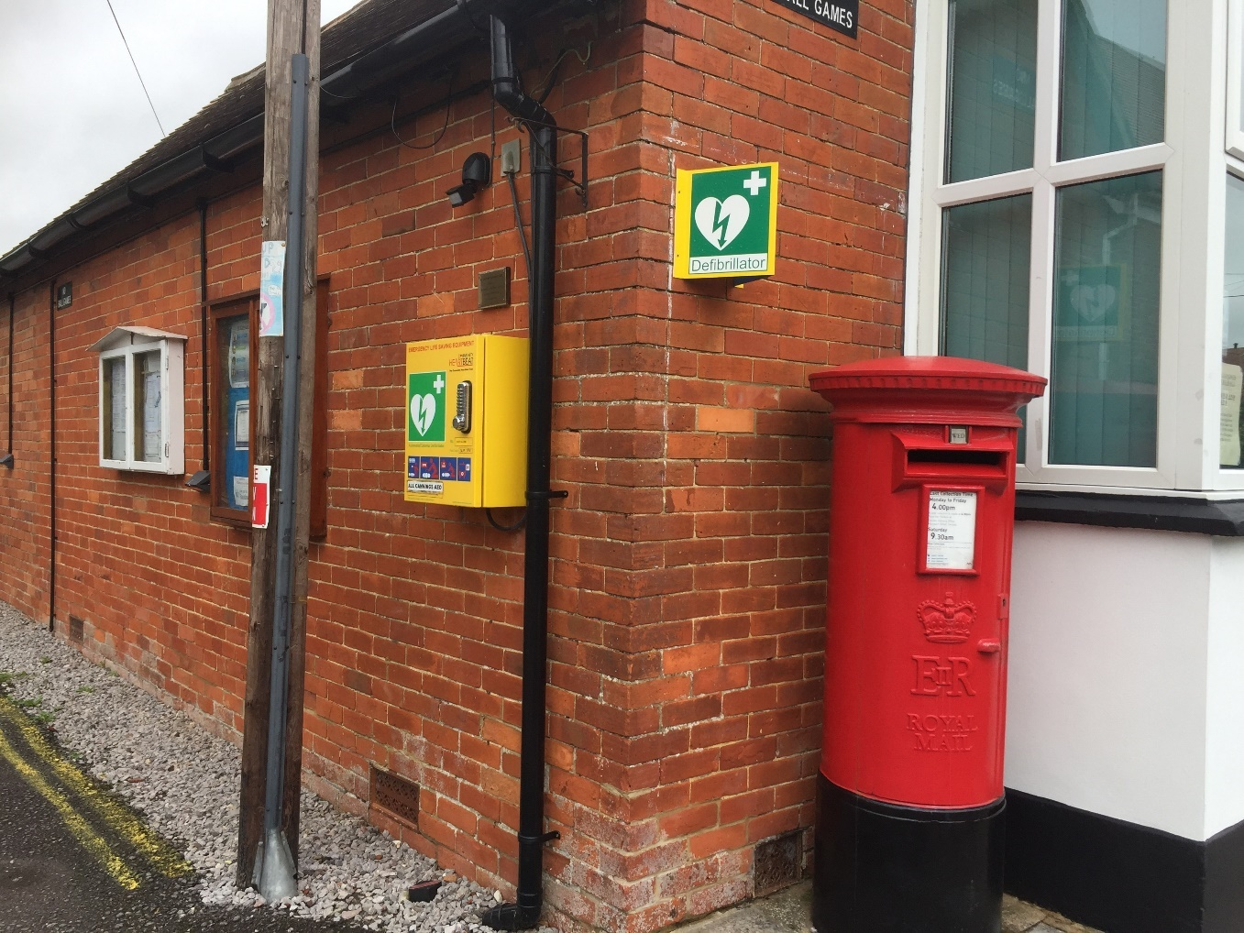
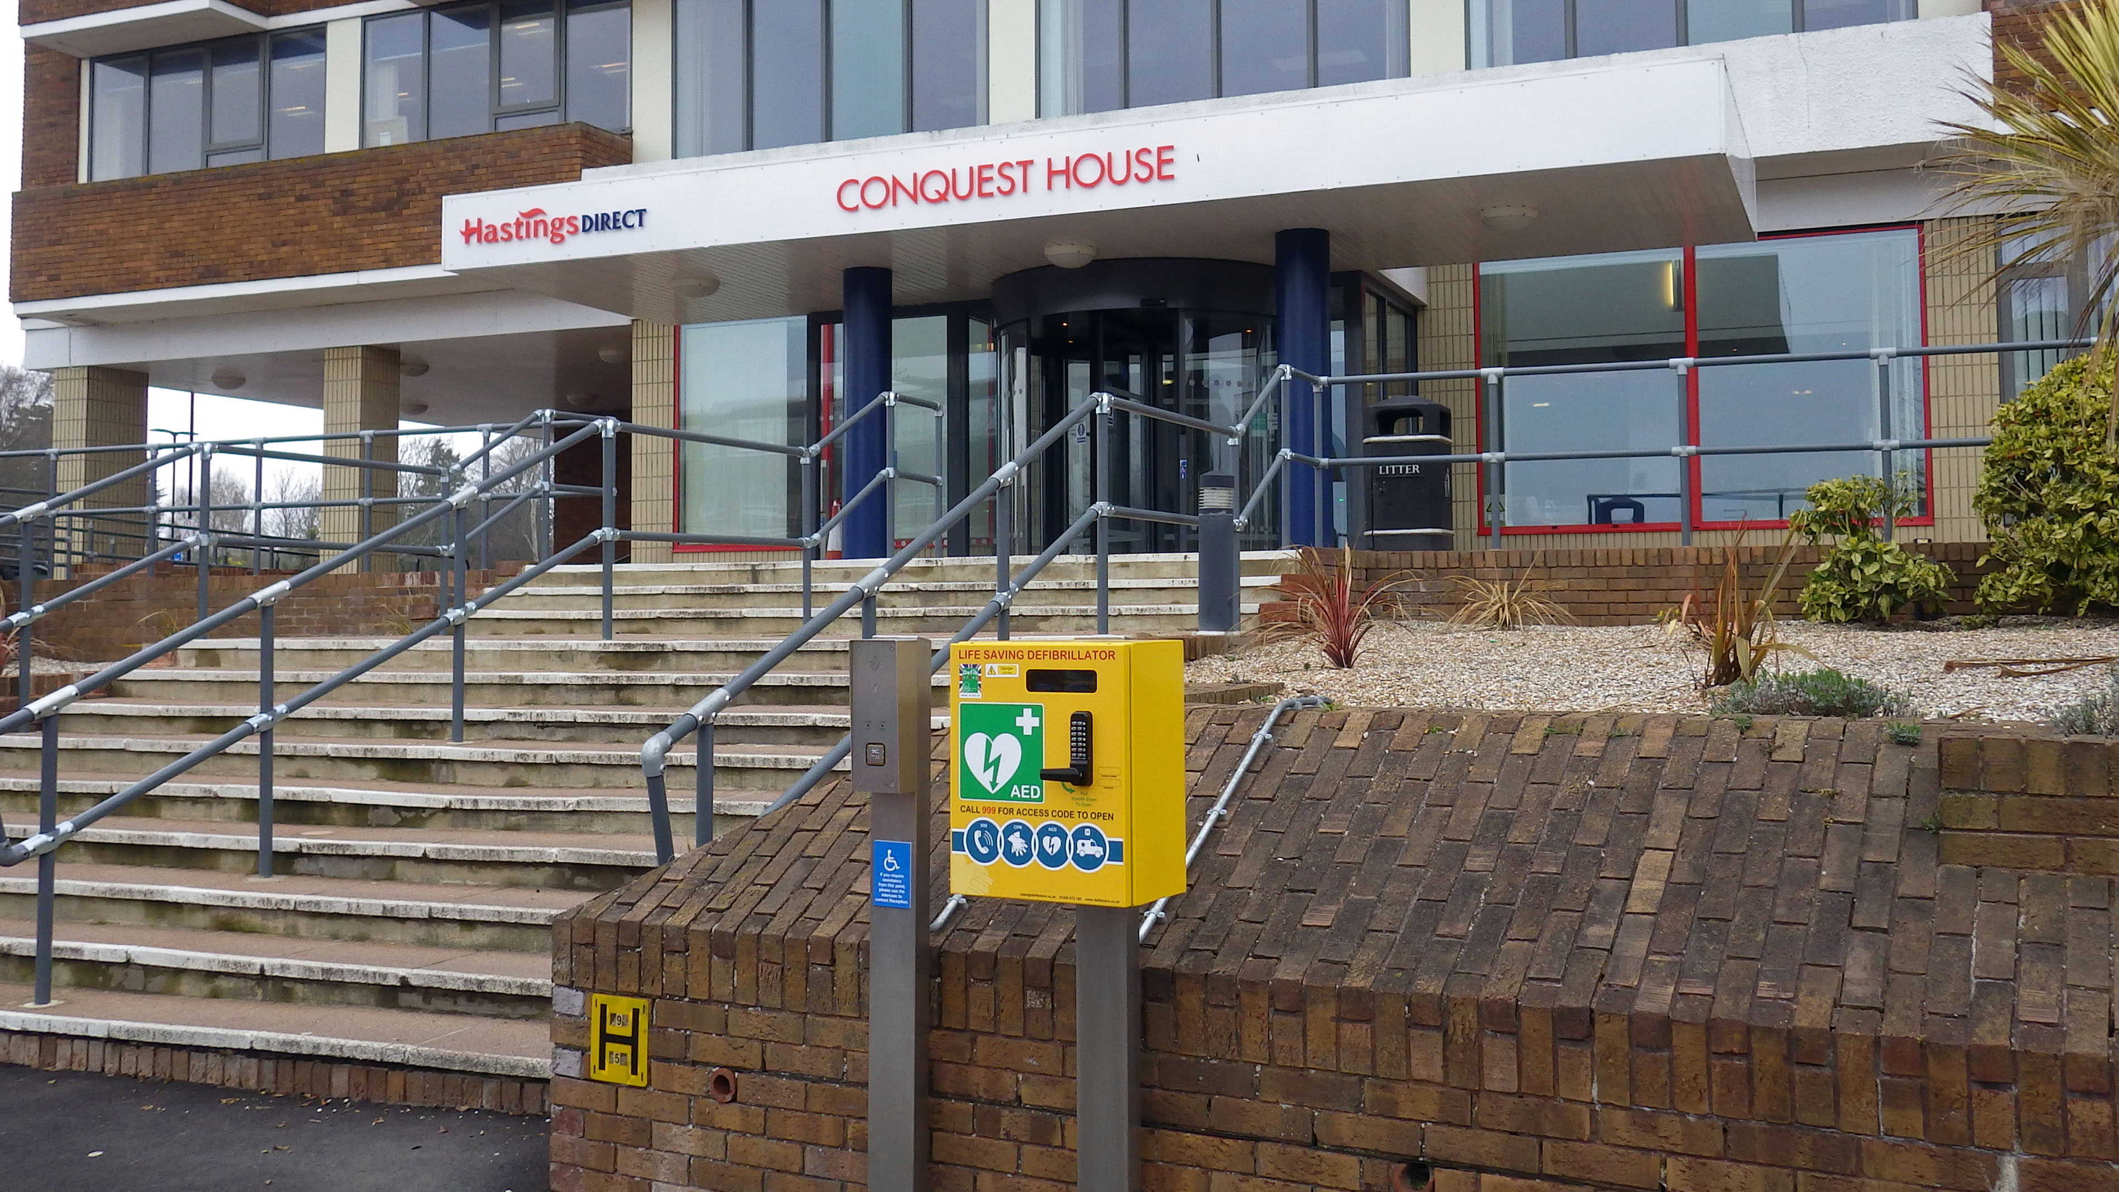
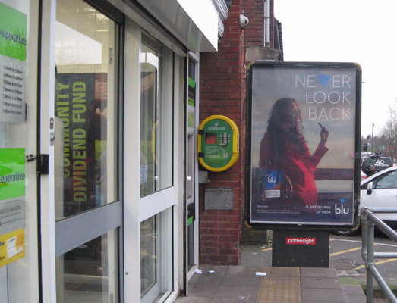
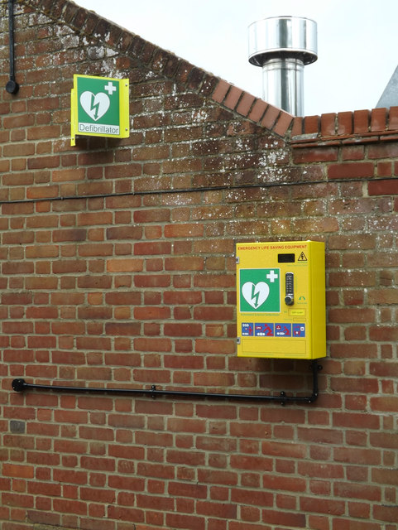
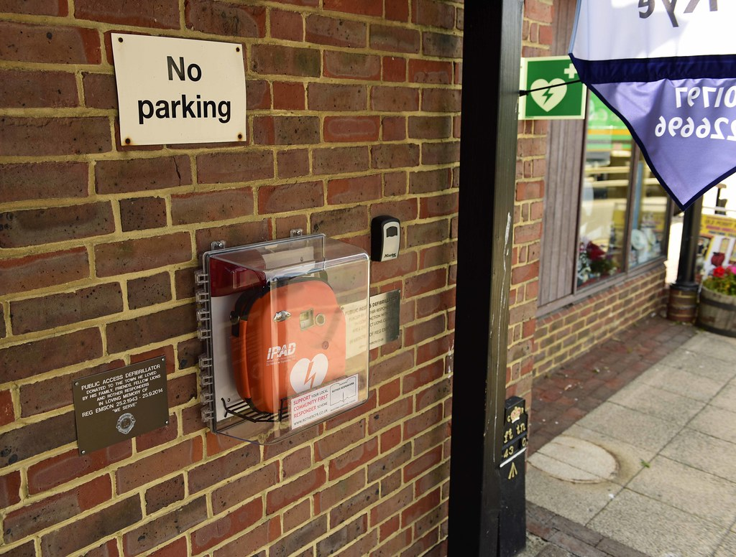
Public Access Defibrillators
You can find AEDs in many public places, including offices, schools, shopping centres, supermarkets and airports. It is important that public places have AEDs because in the event of a cardiac arrest these would need to be accessed quickly; the sooner an AED is attached the sooner it can restart the heart.
KS3 – Basic life support

Slide 21
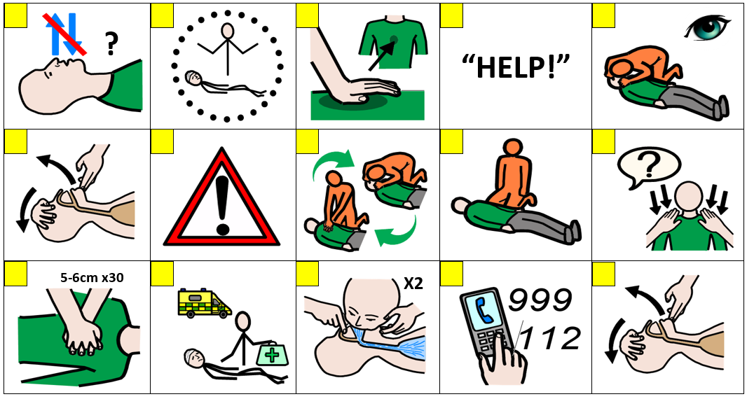
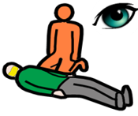
CPR sorting A15 (COVID-19 version)
At this time please do not put your face next to theirs to check for breathing, instead only look carefully for the chest rising and falling.
When giving CPR place a cloth over the face of the casualty
Notes:
Use sorting activity as an option if no mannequins or a large group

Slide 22
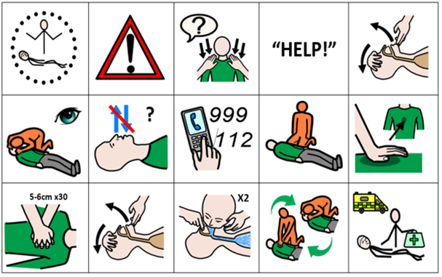
CPR sorting answers A15 (COVID-19 version)
At this time please do not put your face next to theirs to check for breathing, instead only look carefully for the chest rising and falling.
When giving CPR place a cloth over the face of the casualty

Slide 23


Recap
Primary Survey
Breathing normally
Not breathing normally
Recovery position
Call for help and send a bystander for an AED if available
Make sure help is coming and give the casualty care
CPR
Notes:
Just a recap, quick Q and A around room to check learning informally

Slide 24

Roll the dice
Identify something you have learnt from this session.
State why the primary survey is important and describe each part of it.
Explain the chain of survival.
What is the first thing somebody should do if they found an unresponsive casualty and why?
What could somebody do with a casualty who was unresponsive and breathing normally?
How would somebody know if a casualty required CPR?
Notes:
Consider interactive dice

Slide 25
Casualty care
Pause for thought...
Which actions do you think are most important when caring for a casualty?
Get help
No food or drink
Prevent condition worsening
Remain calm
Keep warm
Treat with dignity and respect
Reassure casualty
Communicate well
Notes:
Opportunity to discuss common casualty care skills which are necessary in all first aid situations.

Slide 26



Check your learning
I am able to:
Do a primary survey
I can place an unresponsive casualty who is breathing normally in to the recovery position
I know when and how to deliver CPR to an unresponsive casualty who is not breathing normally (or get help and tell someone else how to do it)
YES UNSURE NO

Slide 27

Check your knowledge
Primary survey
Revisit the starter activity on the first slide of this presentation. Using a coloured pen can you....
1. Add more detail to your previous answers?
2. Make any corrections?
Notes:
Note this activity emulates what it is like to breathe through a narrow airway (similar to asthma)

Slide 28
Information and support
If any of the content in this session has upset or concerned you please discuss this with one of the teachers at your school
Further support can be found at:
www.childline.org.uk
www.youngminds.org.uk
www.samaritans.org
Further information linked to first aid can be found at:
www.sja.org.uk
www.asthma.org.uk

Slide 29

Thank you!

Slide 30
When things go wrong A12
Think of something that could happen to make someone unresponsive.
Notes:
Explain the heart needs air (oxygen) and it’s a muscle that pumps blood around the body.
What can go wrong to cause a problem to the air and blood circulating? (circulation = "circling" the body)
Brief explanation and onto worksheet
General discussion - hit head, run over, choking etc. Emphasis on if it affects breathing, brain or heart (circulation) then this can cause unresponsiveness.

Slide 31
Chain of survival A13
Discuss: Describe each link of the chain of survival
Challenge: Explain why is important to follow these steps to increase the casualty's chance of survival.
Notes:
Can be used as a recap or HW exercise
They may not be able to complete this at this point so can revisit or HW.

Slide 32
Activity A16
The human body
Now you have the opportunity to learn some human anatomy. You could organise human structures and organs onto an outline of a human body. See if you can identify their positions and function. Use our downloadable worksheet which can be found on the St John Ambulance website.

Slide 33
Activity A40
Task choice
Can you achieve 50 points by completing a variety of set tasks? Each task is worth a different number of points. Use our downloadable worksheet which can be found on the St John Ambulance website.

